Slide 1
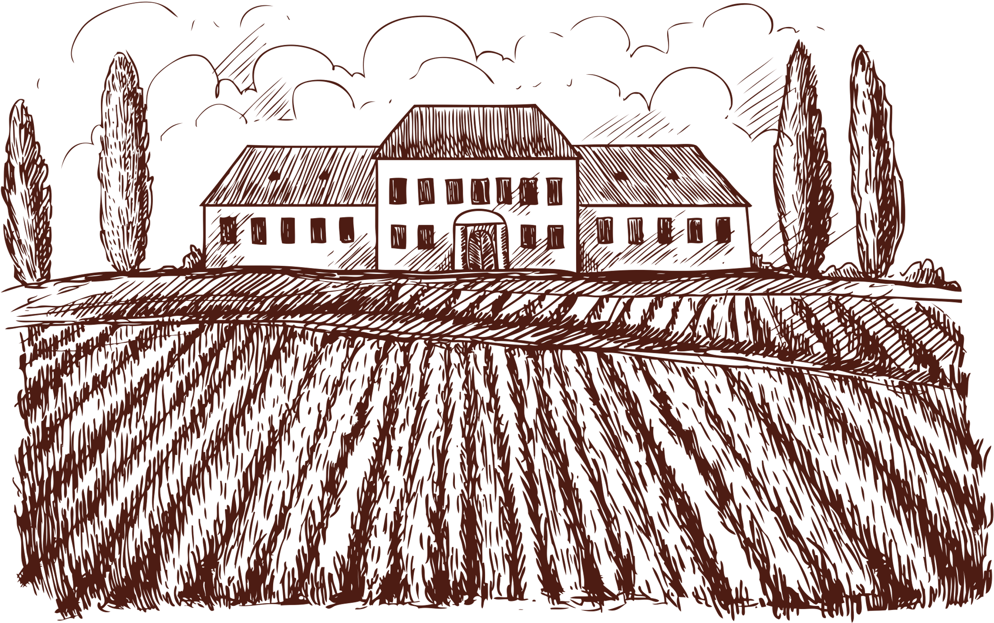
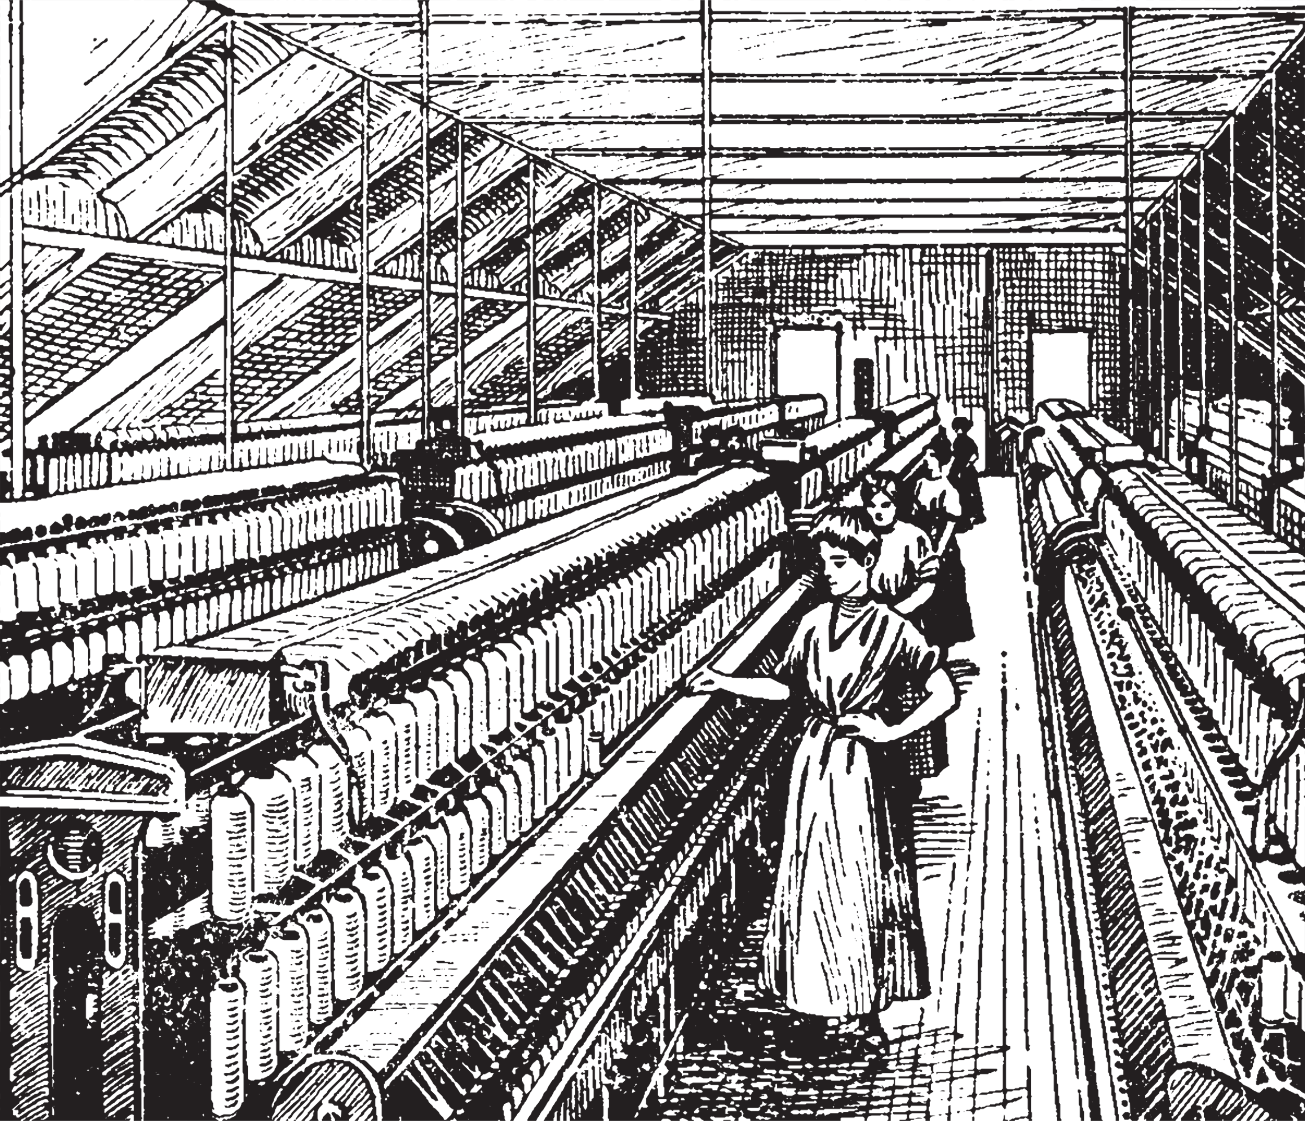
How to Overlay an Old Map onto Modern Map
By Joyce McKenna
A great way to visualize where (and how) an ancestor lived

Slide 2
When is this especially useful?
In any case where the “landscape” has changed dramatically over time (urbanization, for example), or in the event that a building or neighborhood has disappeared, or a residential address has since changed; overlaying an archival map on the modern map is especially helpful.

Slide 3
When is this especially useful?
When trying to make sense of the following:
U.S. Federal Census information
Griffith’s Valuation maps

Slide 4
Example: Patrick McKenna
My g-g-grandfather, Patrick McKenna, was born in Ireland c1822, moved to Scotland, where he married my g-g-grandmother Mary Catherine MacDonald in 1844. He arrived in NY in 1848, and began his American migration, starting in Portsmouth NH, moving on to Lawrence MA, back to NH (Manchester), then finally to Lowell.

Slide 5
Example: Patrick McKenna
A sad figure, Patrick never realized his American dream. He moved from one textile factory job to another, and at some point contracted pthisis (tuberculosis). In the final years of his life, Patrick appeared too sick to continue working. After at least two brief stays at Tewksbury Hospital, he was admitted to Lowell City Farm (aka Lowell Poor Farm, Lowell Almshouse) in 1889.

Slide 6
Example: Patrick McKenna
Lowell City Farm, a sprawling, working farm of up to 150 acres, has completely vanished from the modern map. No longer seen as a viable use of property, the City turned it over to a for-profit organization in 1958. The main building soon burned to the ground, and later infrastructure development (construction of the Lowell Connector) has made it impossible to visualize its original design.

Slide 7
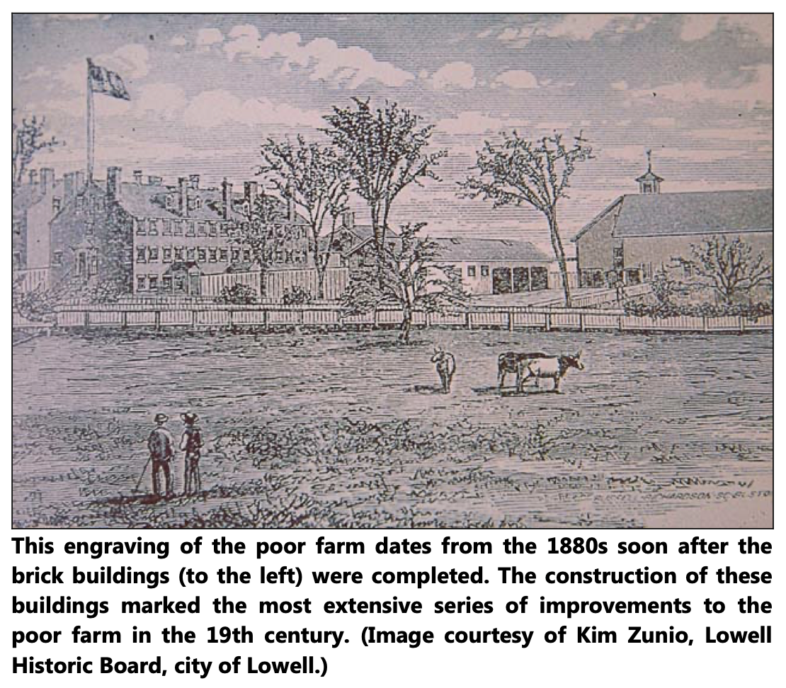
Example: Patrick McKenna
Here’s the fun part!
Family researchers love to imagine an ancestor’s life and surroundings. So, let’s merge two pictures using online platforms.

Slide 8
Example: Patrick McKenna
David Rumsey Map Collection:
https://www.davidrumsey.com/
If you don’t already know of a relevant archival map, it is perfectly fine to use the AI feature to hone in on a useful map. (I already know that there’s an 1871 Gray & Walling map, but let’s pretend I don’t.)

Slide 9
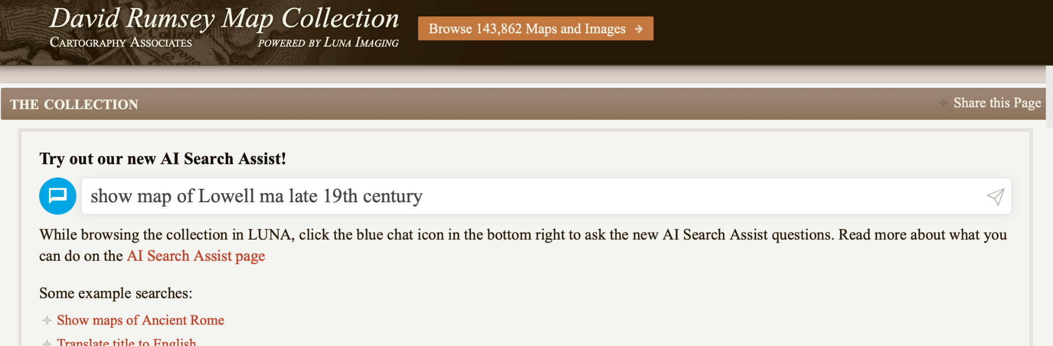
Example: Patrick McKenna

Slide 10
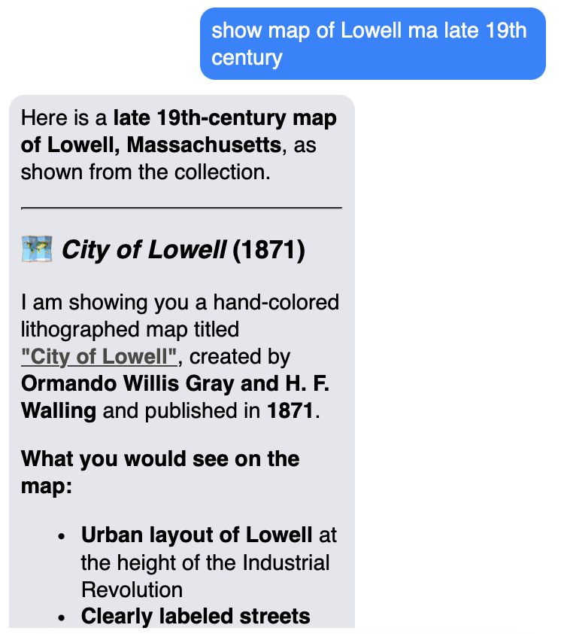
Example: Patrick McKenna
In the site’s AI dialogue box, the “City of Lowell” map I want to use is a clickable link.

Slide 11
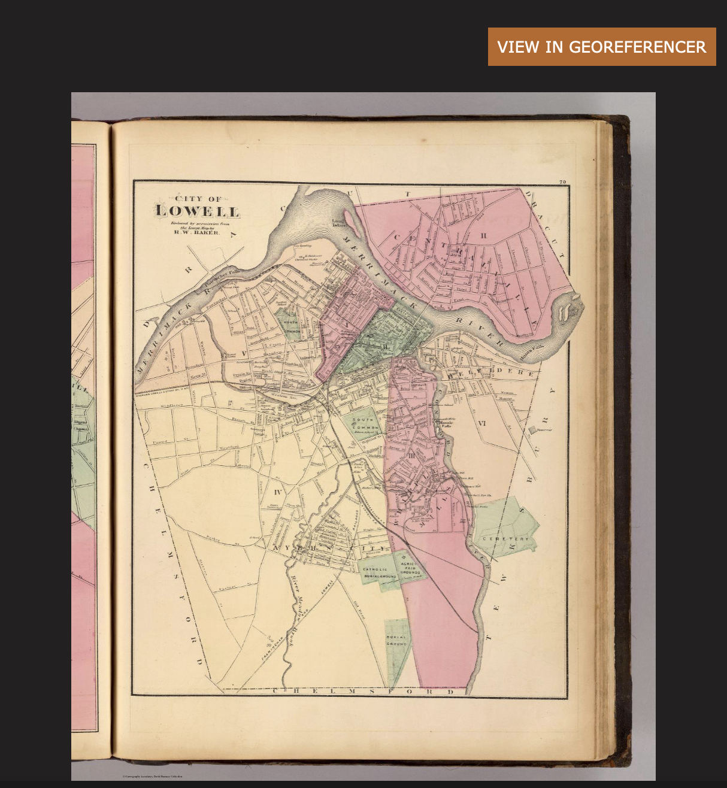
Example: Patrick McKenna
Once we have a workable map, click on “View in Georeferencer” to have this map superimposed over the modern map.

Slide 12

Example: Patrick McKenna
With a little research (online), I was able to narrow down where the City Farm was, since it wasn’t labeled on the old map. (Confession: I am a fan of chatgpt! That’s where I was able to get precise longitude and latitude coordinates.)
The research itself was a delightful rabbit hole.

Slide 13
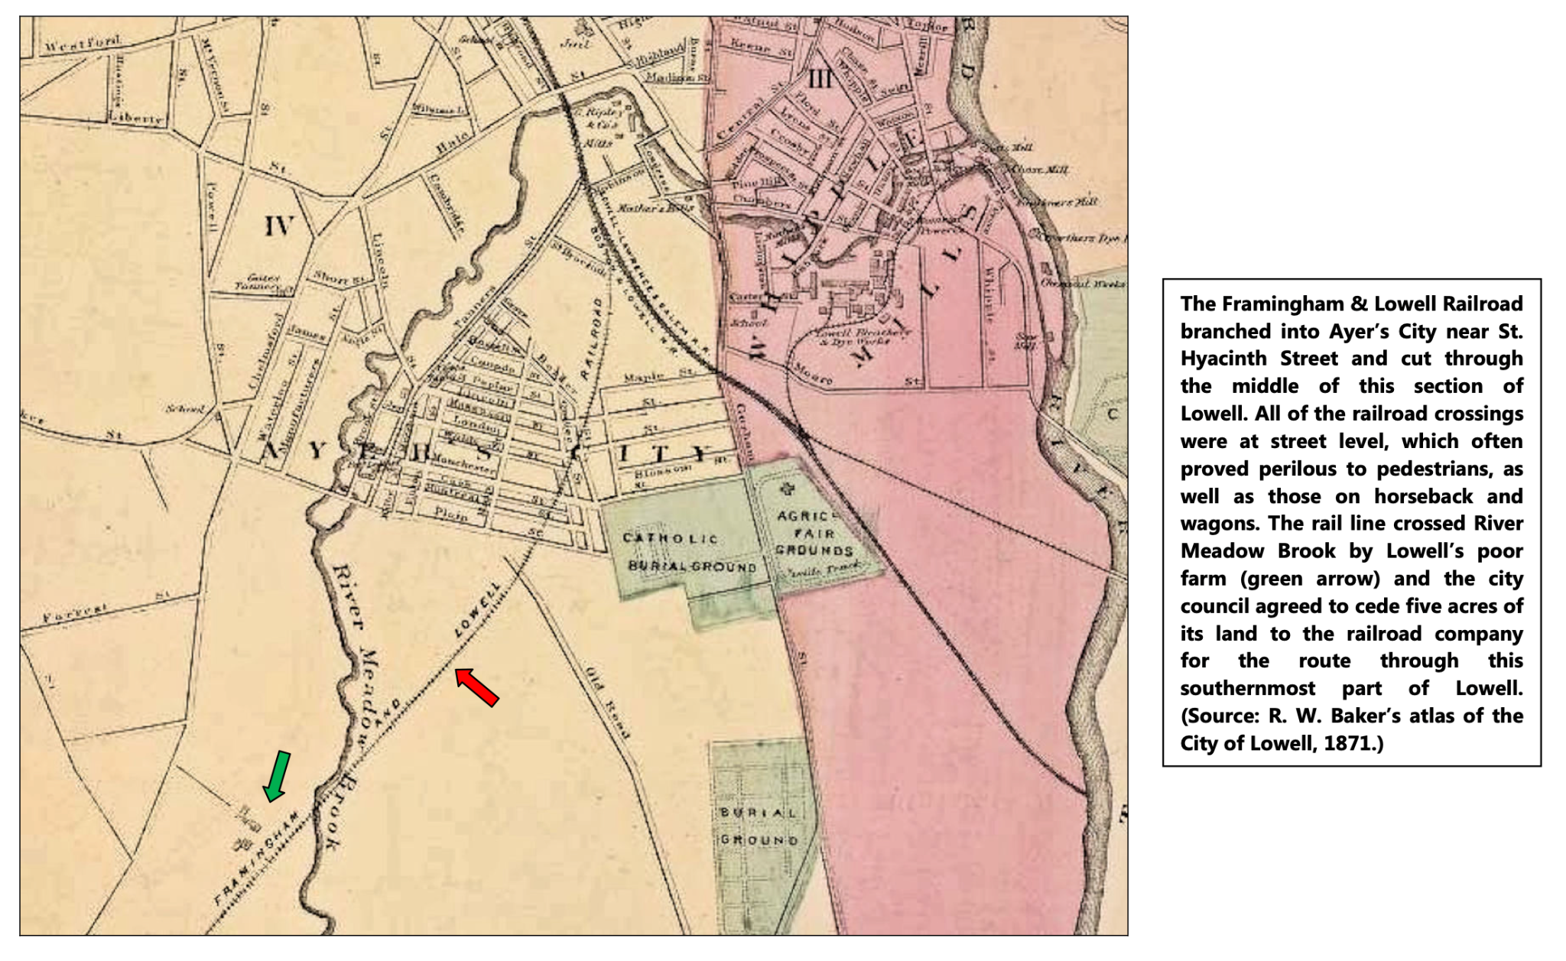
Example: Patrick McKenna
from:
https://lowelllandtrust.org/wp-content/uploads/2016/11/Changing_Course_A_History_of_River_Meadow_Brook_Final.pdf

Slide 14
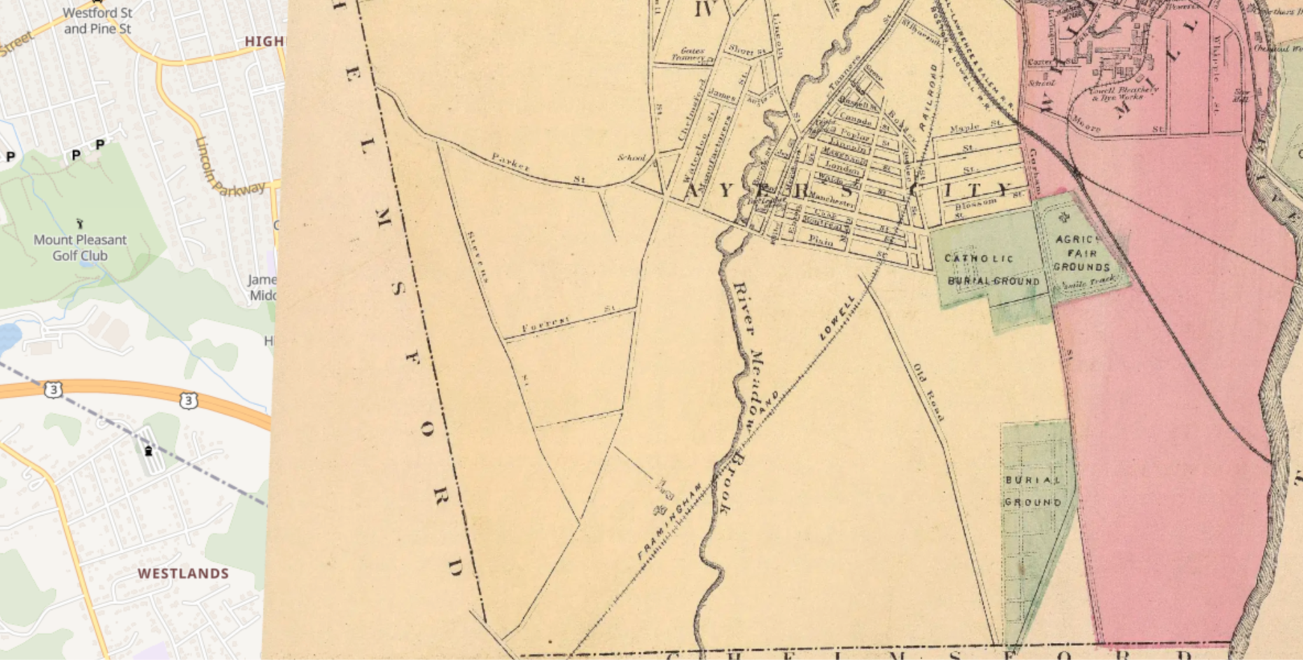
Example: Patrick McKenna
Now back to the map overlay (with my understanding of where to look for the City Farm.)

Slide 15
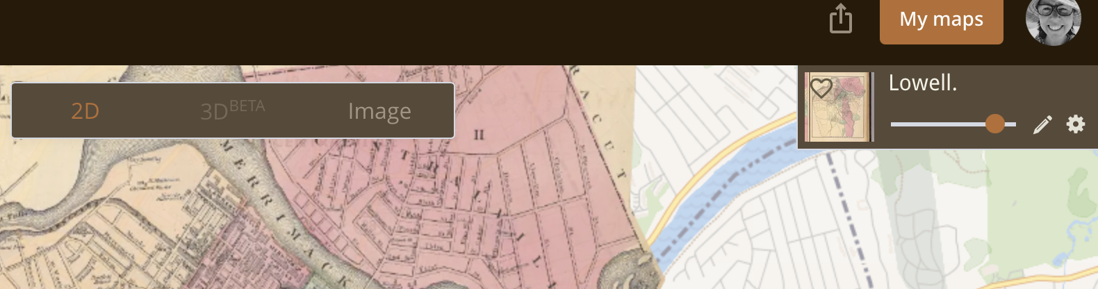
Example: Patrick McKenna
This is the most fun part of the interactive exercise! Play with the slider to increase or decrease the transparency of the old map overlay.

Slide 16
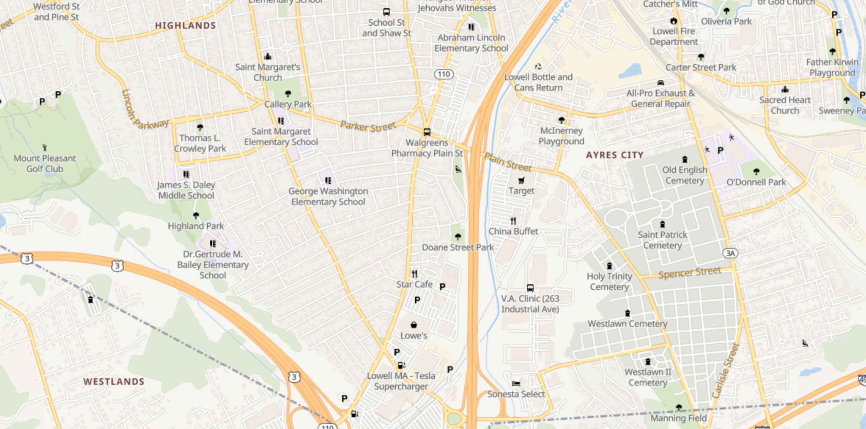
Example: Patrick McKenna
Lowell City Farm was in between Chelmsford St (Rte 110) and the River Meadow Creek, right where Lowe’s is now. (2025)

Slide 17
Sources
https://lowelllandtrust.org/wp-content/uploads/2016/11/Changing_Course_A_History_of_River_Meadow_Brook_Final.pdf (See p220)
www.DavidRumsey.oldmapsonline.org
chatgpt.com

